Slide 1
Deep Learning CA2 Part A
Jeyakumar Sriram (p2214618)
Shawn Lim Jun Jie (p2239745)

Slide 2
Objective
Build and train a Generative Adversarial Network (GAN) capable of generating fake images with the CIFAR-10 dataset.
We will perform the necessary feature engineering, understanding the data, build our base model and improve upon it. We will also be trying out different GAN architecture design to see if they can perform better.

Slide 3
The problem with the dataset
Low resolution images
CIFAR-10 dataset issues
01
All images are 32x32 pixels, making it challenging capture the image details
Limited diversity
02
With only 10 classes, it may not be sufficient to train complex models
Image mislabelling
03
It’s been known that CIFAR-10 contains mislabelled images.

Slide 4
Feature engineering
Steps taken
Handling mislabelling | Identify mislabelled data and reclassify them
Normalisation | Scale the image data to [-1, 1]
One Hot Encoding | Since the labeled data is nominal, one hot encoding has to be done
DiffAugment (to be later try as model improvement) | Applying differentiable augmentation on the real and generated images

Slide 5
Feature engineering (Handling mislabelling)
Handling mislabelling
Reclassify the mislabelled
04
The steps to fix all the mislabelled data.
Use the second ResNet model to reclassify
Train another model
03
Train another ResNet without mislabelled
Identify the mislabelled
02
Use the calculated AUM to find the mislabelled
Train a model
01
Train a ResNet model to compute the AUM

Slide 6
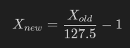
Feature engineering
Normalisation
A generator in GAN will usually use Tanh activation function in the output layer.
This means the generated image data will range from -1 to 1.
To keep things consistent, the real images will also be scaled to -1 to 1.
One Hot
We will be using GAN models that make use of the dataset label.
Hence, it is necessary to perform some augmentation to transform the label appropriate for the model.
Since the label is nominal (a dog is not objectively better than a cat), it is best to use one hot encoding.
Formula to apply scaling

Slide 7
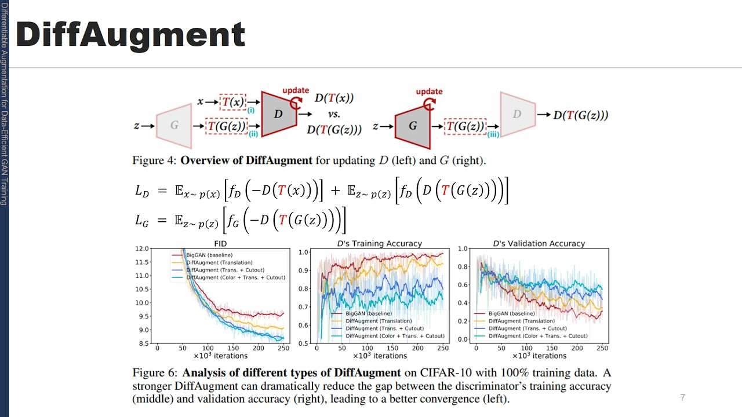

Feature engineering (DiffAugment)
Differentiable Augmentation (or DiffAugment) allows us to perform data augmentation while also letting the model to adjust the augmentation.
This novel approach has been shown to achieve state of the art result on CIFAR-10 and CIFAR-100.
We will go into further details later as we are using it as part of model improvement later on, to highlight that this idea works really well.

Slide 8
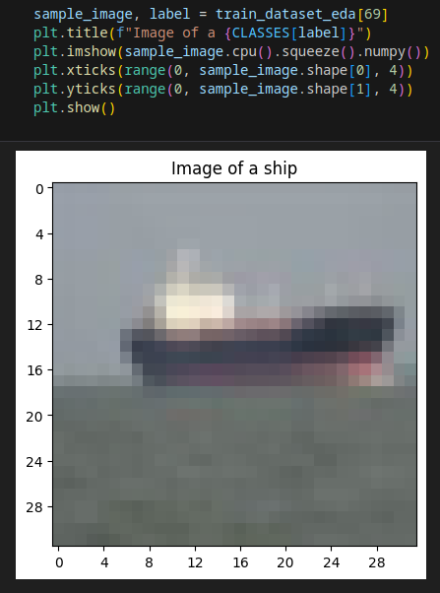
CIFAR-10 dataset EDA
We sample a random image to see how the image will look like.
This shows that having a 32x32 pixel images clearly hides all the details, especially the image of the ship, but we can vaguely see the sky, the ocean, as well as the outline of the ship.

Slide 9
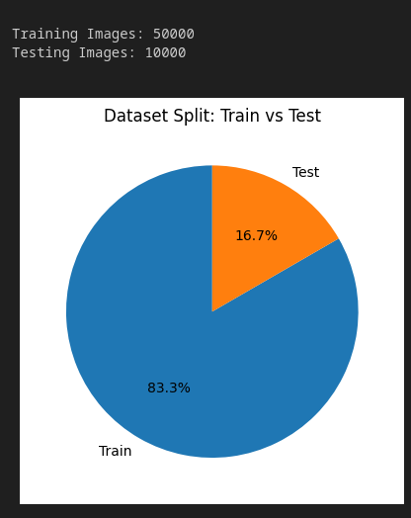
CIFAR-10 dataset EDA
We show the number of training and testing images and the proportion.
We can simply see that the training makes up ⅚ of the total dataset.

Slide 10
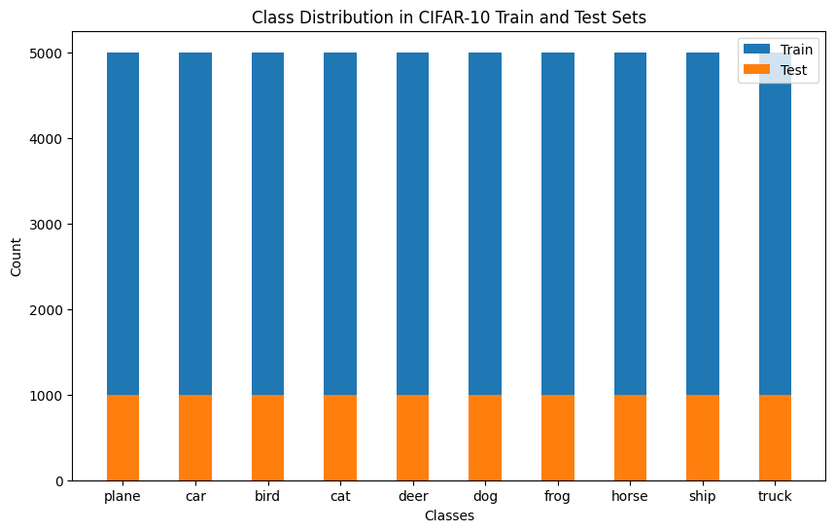
CIFAR-10 dataset EDA
We show the number of images for each class in the training and test images.
This is to confirm that the dataset has no imbalance.
So, we don’t need to perform any oversampling and such.

Slide 11
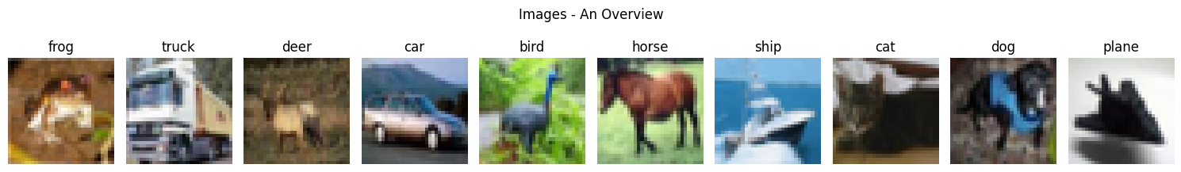
CIFAR-10 dataset EDA
We show a quick overview on how each image would look like for each class.

Slide 12
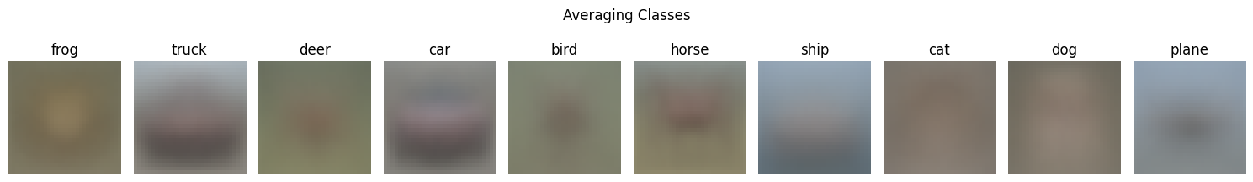
CIFAR-10 dataset EDA
We also show a preview on what each class would look like if we average all the pixel values for all the images in each class.
This is to roughly see how each class would look like “overall”.
For example, we can see some vehicle outline for truck and car, and we can see blue background for ship, since ocean is always blue in colour.

Slide 13
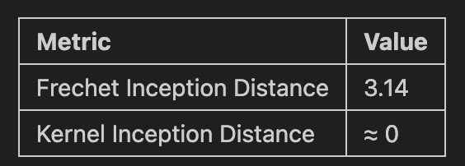
Evaluation metrics
Inception Score
Fréchet Inception Distance
Kernel Inception Distance
The higher the better
Uses InceptionV3 to classify fake images
Outputs probabilities of fake image belonging to the classes and compare to marginal distribution
Seeks to find quality and diversity of images
The lower the better
Builds on top of the Inception Score
Uses the model’s final pooling layer to extract the information.
Seeks to find the realism and diversity of images
The lower the better
Improvement over the FID by using Maximum Mean Discrepancy instead to compare distribution.
Requires fewer samples, thus better for CIFAR-10.

Slide 14
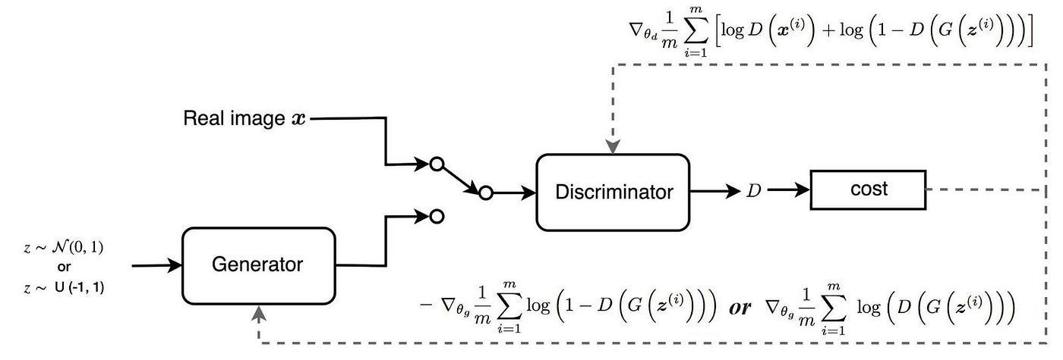
Generative Adversarial Network
Generative Adversarial Network, or GAN for short, features two models competing against one another with the objective to make the generator generate data as close to training data as possible.
First shown to be viable by Ian Goodfellow and his colleague on the paper “Generative Adversarial Network”
The idea is that generator takes in a set of noise to produce fake images, while the discriminator takes in both the real and fake images, and predicts whether each of them is real or fake.

Slide 15
Issues with training a GAN
 | Common challenges that can arise when training a GAN
01 | Discriminator becoming too strong | This happens when discriminator loss keeps going down while generator loss goes up. When it happens, generator will unable to fool the discriminator and not learn
02 | Generator becoming too strong | This happens when discriminator loss plateau and the generator loss keeps going down. When it happens, discriminator will not be able to provide info on backpropagation
03 | Mode collapse | This happens when the generator learns to only generate one specific type of image and fool the discriminator effectively
04 | Vanishing gradient | This whens the backpropagation becomes “ineffective”, which can cause discriminator to be less sensitive to feedback and provide weak feedback. Consequently, it can cause generator to not learn much.

Slide 16
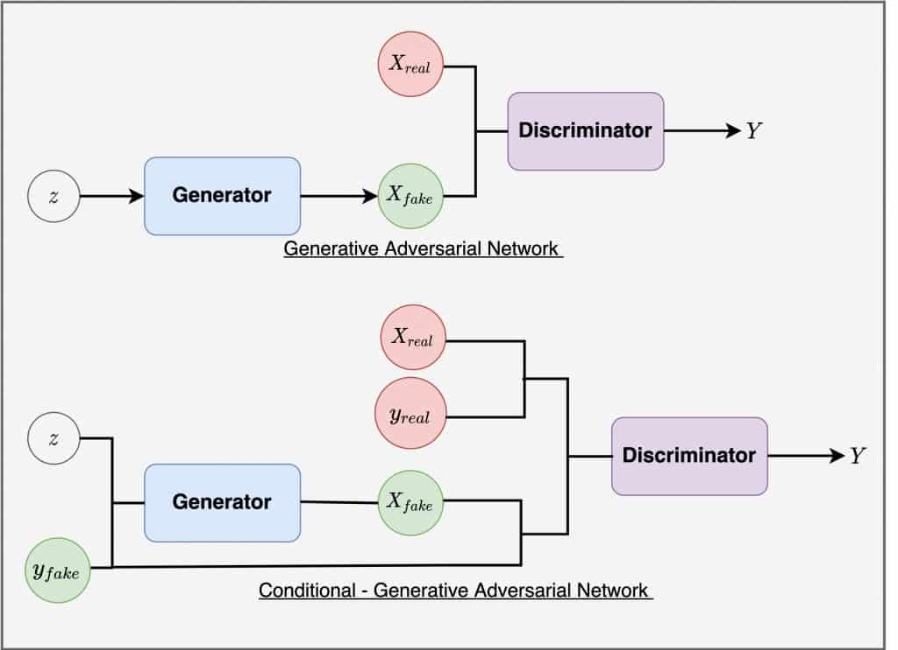
Theory behind conditional Generative Adversarial Network
The problem with vanilla GAN:
Ignore image classes, results in all images blending together
No control on what class you want to generate
With cGAN:
Simply input class label to both discriminator and generator as additional input
Allows for class-specific image generation
We hope that it will learn to distinguish and generate images specific to the input class
We will be using cGAN as our baseline model, so we can compare to later improvements and other architectures.

Slide 17
cGAN implementation
In our implementation, we follow the suggested modification from authors on Deep Convolutional GAN.
Build the discriminator and the generator, with the ultimate goal to “fool” each other.
Both the discriminator and generator will have their own optimiser and potentially different learning rate.
The way we do “conditioning”, where we “combine” the noise or image with the label, is to simply concatenate.
We use a modified Minimax loss function as binary cross entropy can result in vanishing gradient, while the original Minimax can result with issues in early stages of training.
Finally, we let the model run for 500 epochs, and observe its results and images as it train.

Slide 18
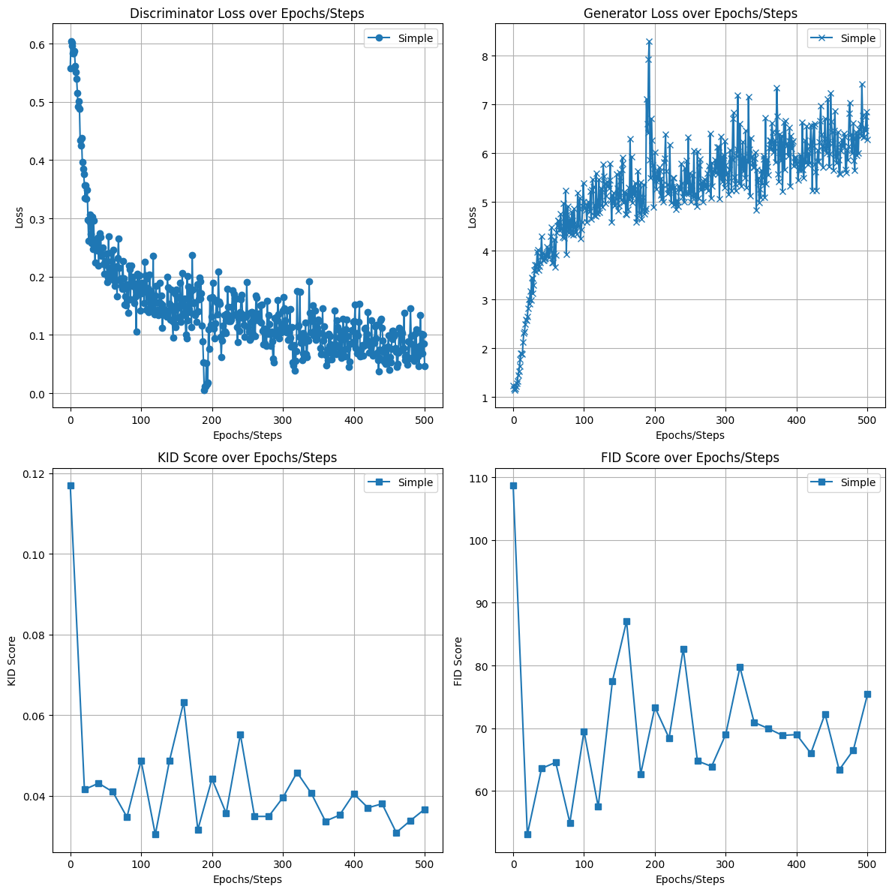
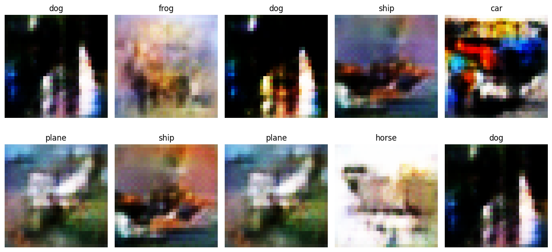
Basic cGAN results
Result does not look promising, as the generator loss goes up while discriminator loss goes down.
Additionally, images in the same class are almost identical, suggesting a mode collapse. Some images have artifacts as well.
FID and KID score are unstable as the model trains.

Slide 19
Model Regularisation
We apply the following regularisation techniques:
Label smoothing: Instead of the discriminator outputting exactly 1 or 0, it will output modified values where 1 will be smaller, and 0 will be larger. This is to reduce the sharp decision boundary between 1 and 0 which can result in unstable training.
R1 regularisation: Adding weight penalty to loss function that is proportional to the sum of all the weights in the model. This is to combat overfitting in the discriminator.
Originally, we would use upsampling and downsampling to improve model as well, but it can lead to artifacts so we didn’t adopt this idea. Despite being able to resize with nearest neighbours to upsample, it led to poor results.

Slide 20
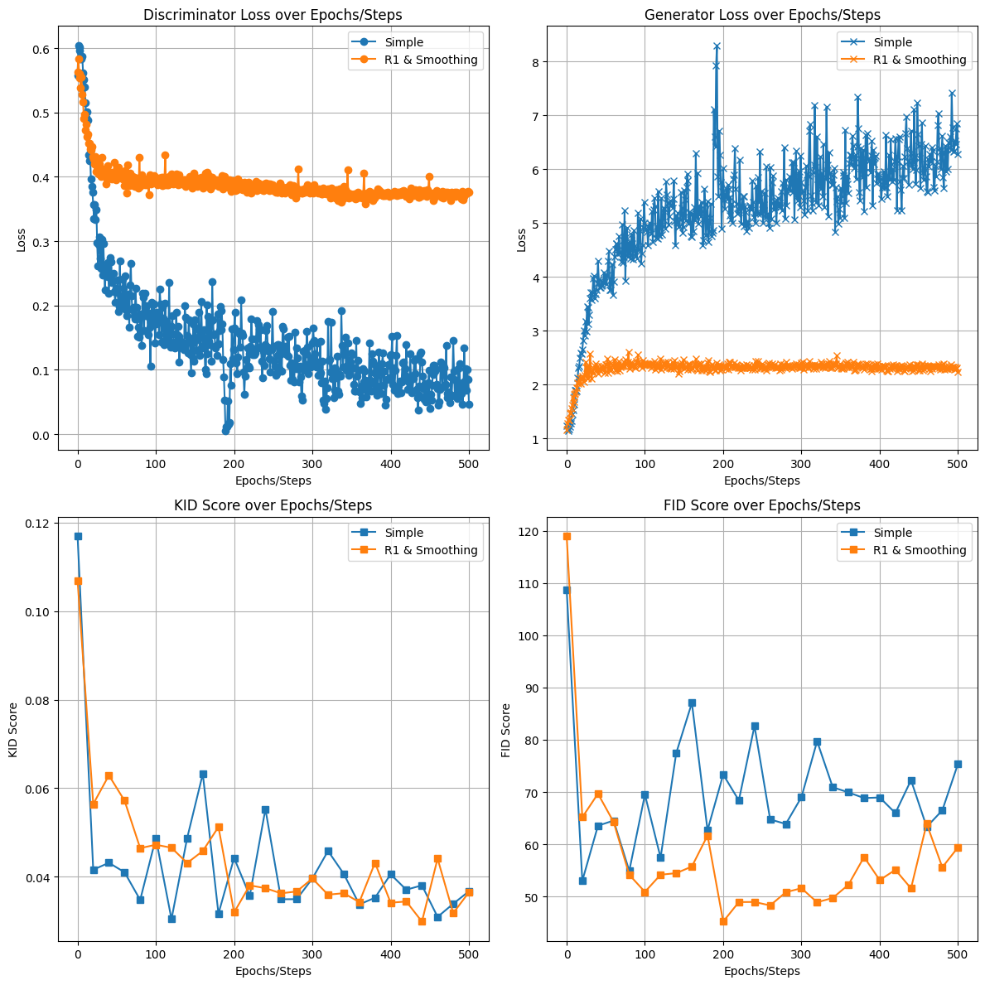
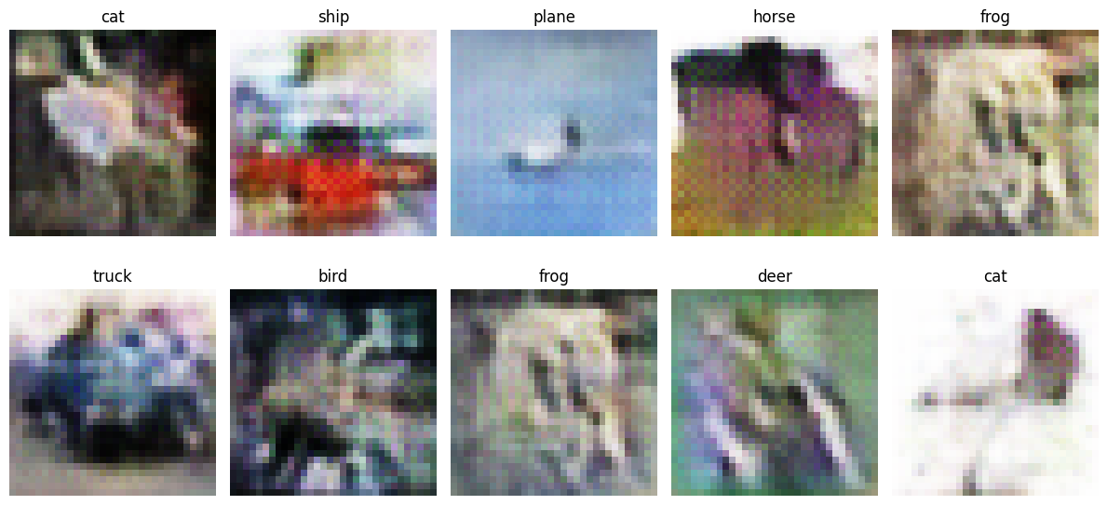
Regularised GAN results
Now the generator is overpowering the discriminator as generator loss drop while discriminator loss plateau.
FID dropped much lower but goes back up.
Images look fine but with some mode collapse, especially the frog images.

Slide 21
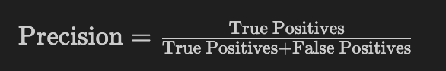
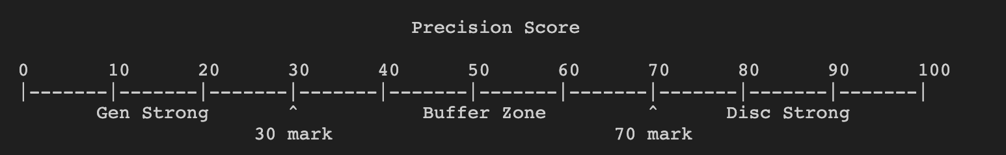
Balanced GAN
Our current issue right now is discriminator or generator overpowering each other. Hence, we decided to try out balanced training that will stop training one of the models if it gets overpowered, so as to let the other model catch up.
Precision score (in our case, positives are real images, negatives are fake images) will be used to measure how powerful the models are.
Establish baselines such that when the precision falls below a certain line, the generator is overpowered, or when the precision reaches a certain line, the discriminator is overpowered.
Use circular buffer to store past precision scores as we don’t think is right to simply calculate precision for every batch.

Slide 22
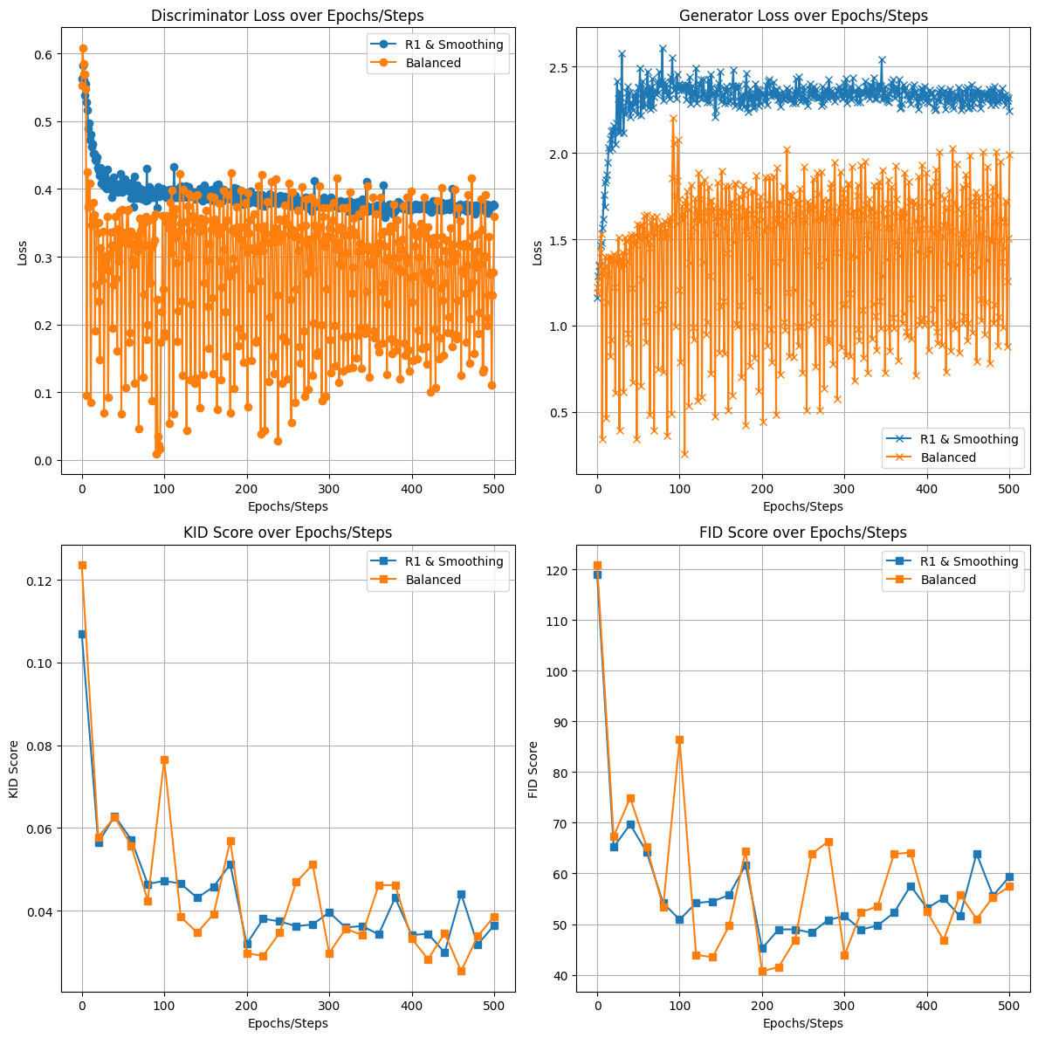
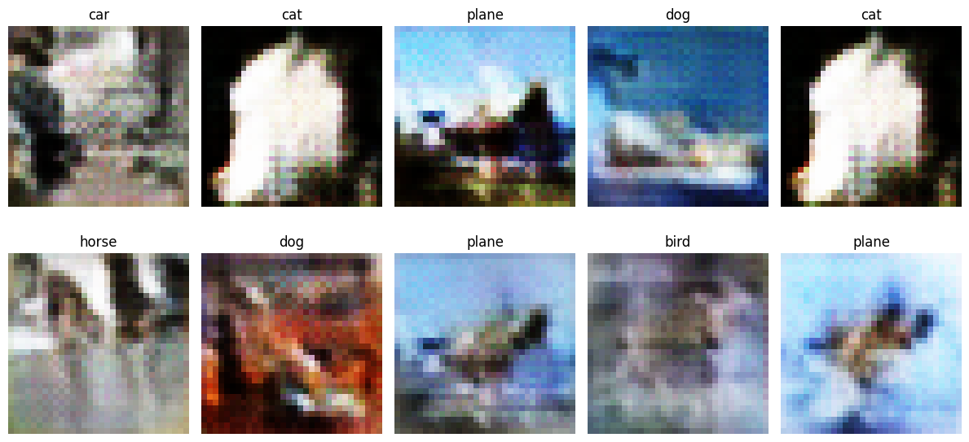
Balanced Model results
KID and FID score looked similar to previous improvement but with more variance.
FID score started deteriorating after 250 epochs, probably due to training too long.
Discriminator and generator loss suddenly have high variance, making it hard to observe any trends.

Slide 23
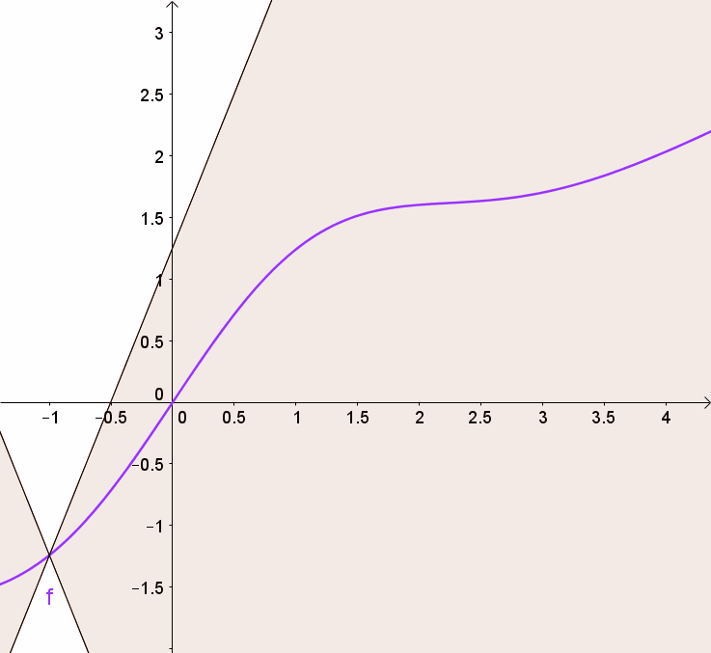
Spectral GAN
We would also like to apply spectral normalisation, which is often used in GAN to promote training stability and convergence. Intuitively, this is to prevent weights from changing too quickly.
By adhering to Lipschitz continuity whereby there exists a real number that is greater than all possible gradients on a function, we can let the discriminator bound to a certain constant to prevent exploding gradients and mode collapse.

Slide 24
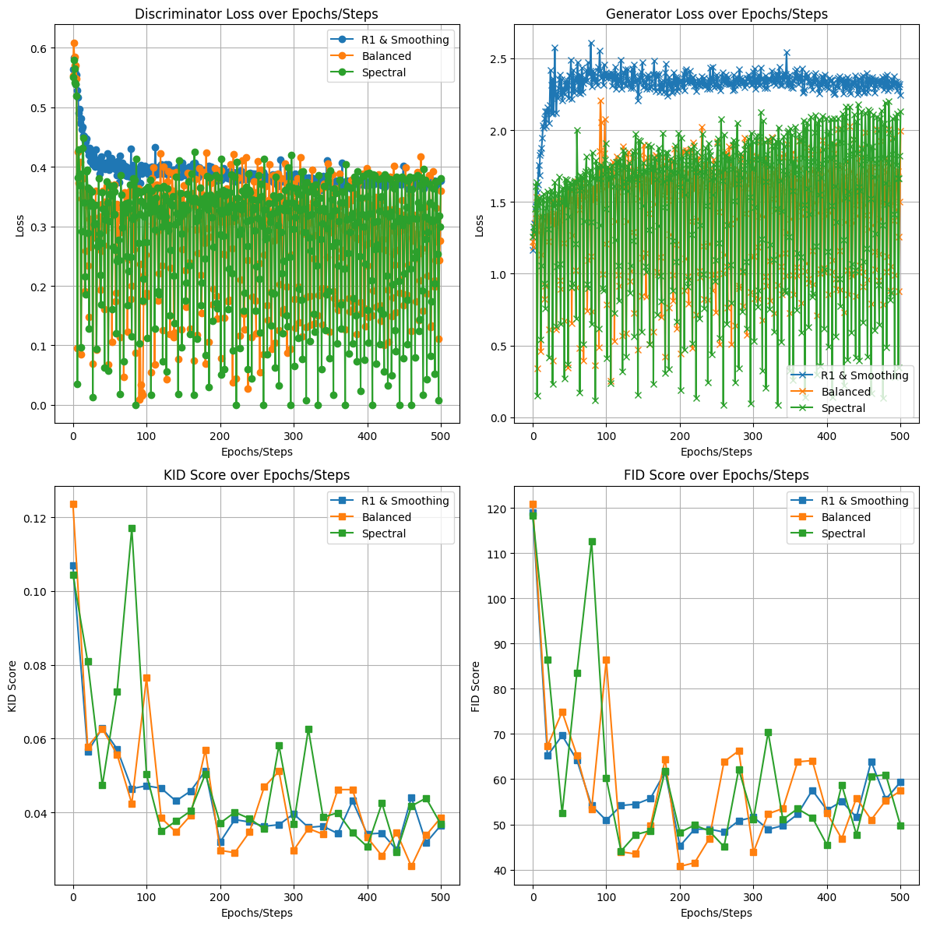
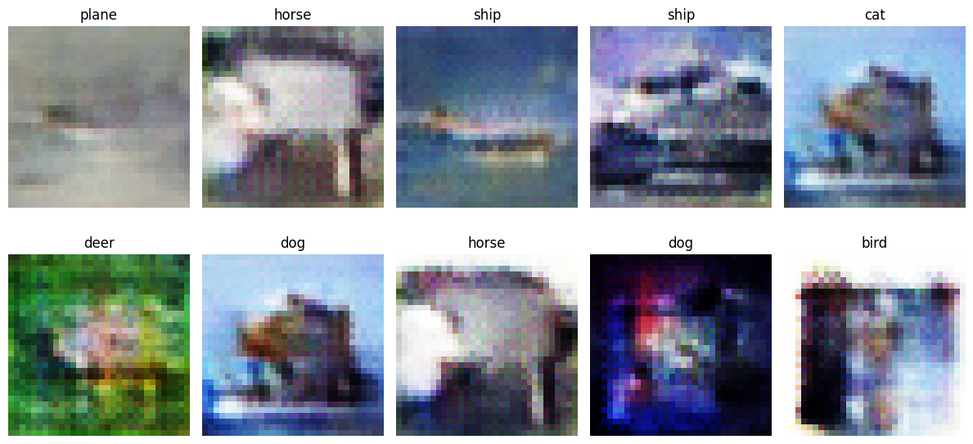
Additional model improvement 2 results
Very similar to balanced training, as if no improvements at all.
This can be seen as the KID and FID score follow similar trend, with similar variance.
And the discriminator and generator loss are also high in variance, in fact, similar in variance.

Slide 25
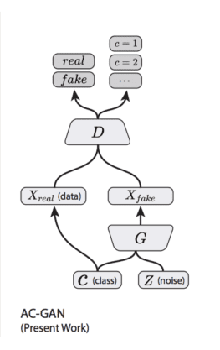
ACGAN
One problem we noticed when training was that the model didn’t seem to take into account the label and would generate something unrelated.
Hence, we decided to try out Auxiliary Classifier GAN (ACGAN).
The discriminator now does not take in the labels
The discriminator also has to output the predicted label, after outputting whether is real or fake
This can be done by having a dedicated auxiliary classifier built into the discriminator to classify images
Together, both the generator and discriminator optimise the combined objective of both the adversarial loss and auxiliary classification loss
Hence, this should promote the generator to produce both realistic and class-specific images

Slide 26
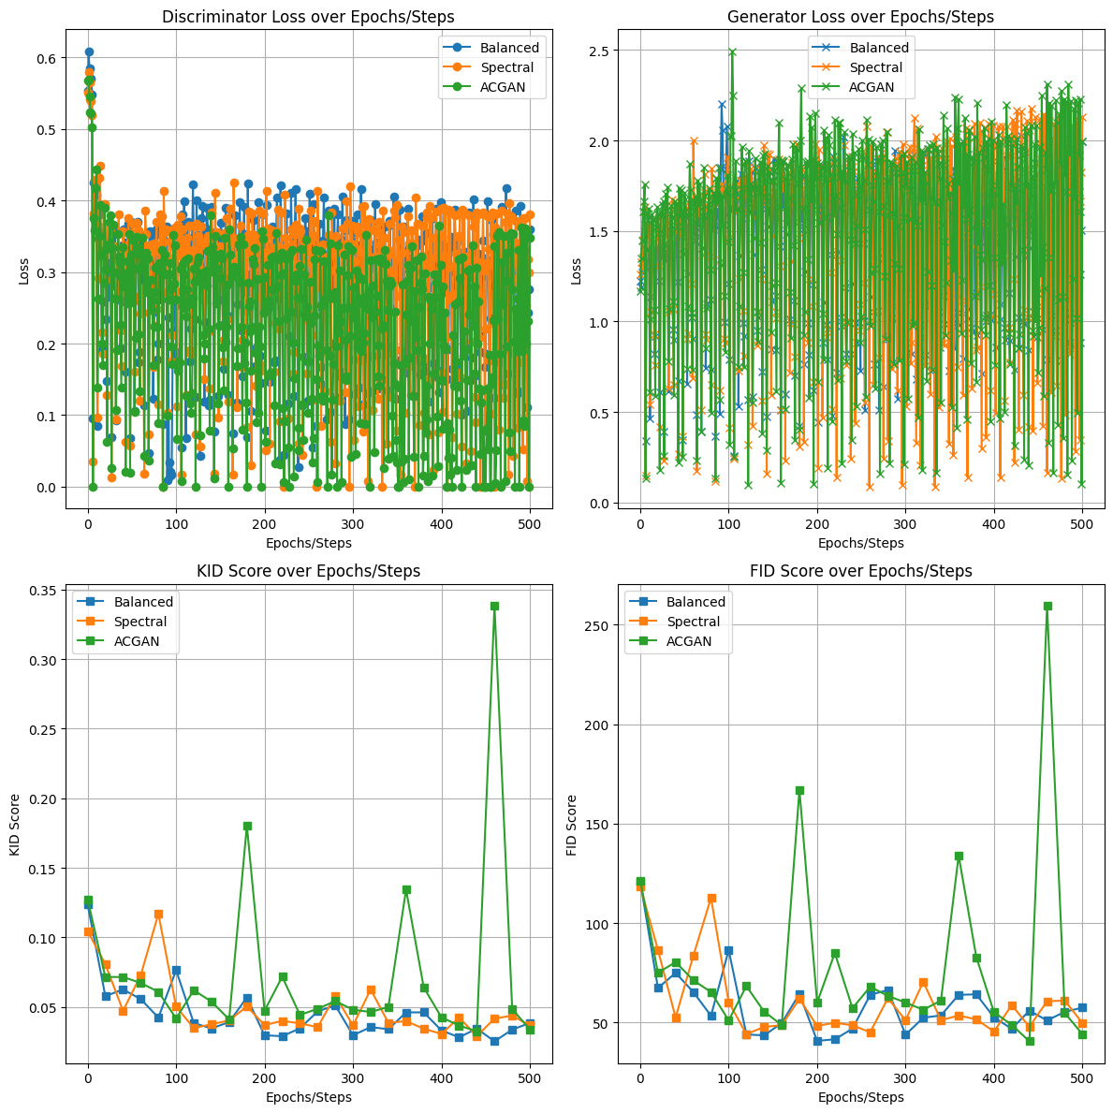
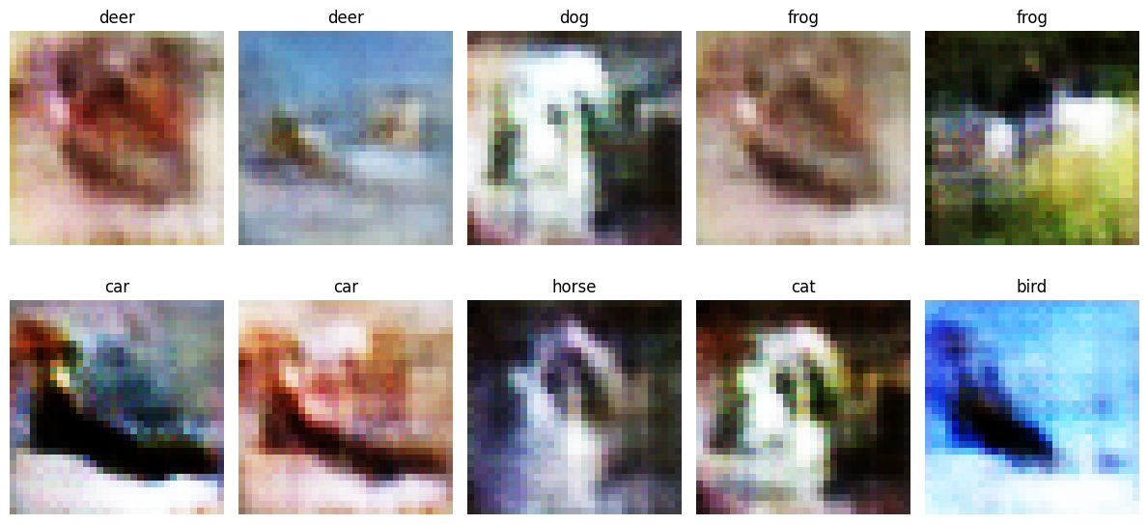
ACGAN results
Seems to be unstable as there are huge spikes in KID and FID score in certain epochs.
Still have high variance in loss, but slightly less for discriminator.
Images look unrecognisable, especially with their labels.

Slide 27
Embedding GAN
The use of embeddings
Before
After
Concatenating the noise with the labels
Hard to control the output at the end
Model most likely forget the labels concatenated
Perform element-wise multiplication on the noise with the labels
Ensure the labels have big impact on initial state of latent vector
Inspired by AdaIN from styleGAN

Slide 28
Modifying Generator Loss
Generator backpropagation using both Adversarial Loss and Classifier Loss
Not only are we changing the embedding, we are also modifying the generator’s loss.
We found that the generator is not learning the labels correctly
We thought that the classifier loss was backpropagated in discriminator, but not on the generator
Hence the generator barely learns about how the labels associated with the outputs
We propose to modify the generator loss to include the classifier loss
We will use the same auxiliary classifier loss used for discriminator in the generator
Simply get the label prediction from the discriminator and compare to the actual label, and we’ll get the auxiliary classifier loss which is added to the original loss for generator
However, simply adding the auxiliary classifier loss to the generator loss will result in poor performance, hence we add weighted sum on both the losses

Slide 29
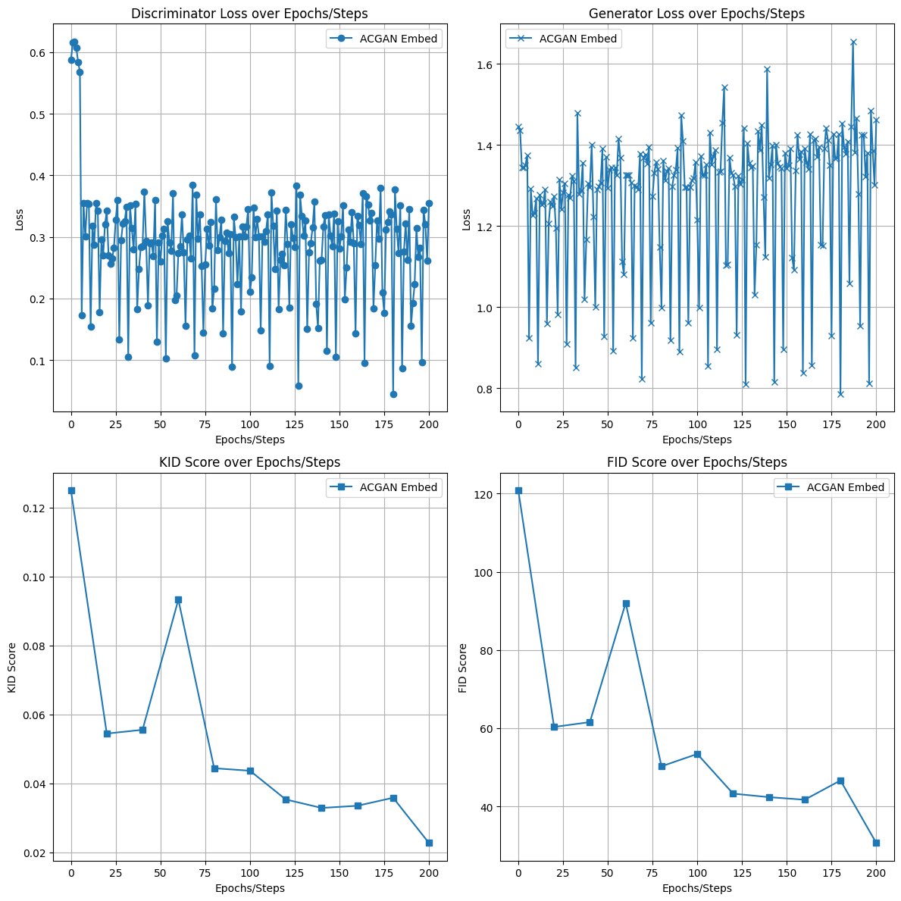
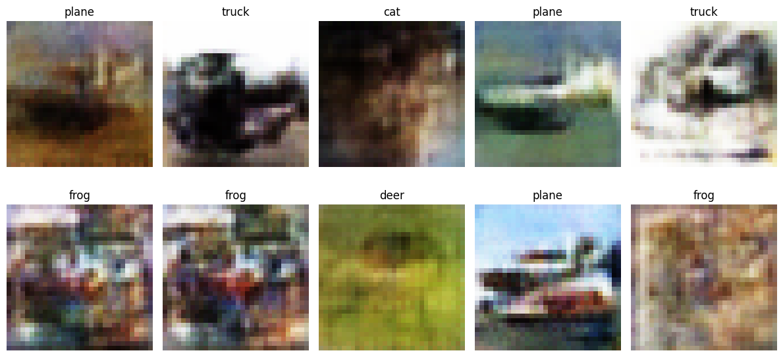
Embedding GAN
We have decided 200 epochs is enough, and we obtained impressive KID and FID scores.
Discriminator loss is less varied but generator loss seems to be getting more unstable.
Images seem to fit the classes fine, but with some mode collapse.

Slide 30
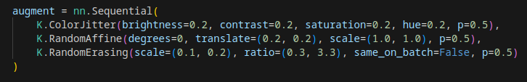
Final model improvement
We will now use DiffAugment to do our model improvement.
Instead of building from scratch, we use the library called Kornia to perform the DiffAugment
We modify the discriminator such that all data inputting it will be applied with the augmentation
We also remove the R1 loss as we are now using DiffAugment
Here are the augmentations that we will apply:

Slide 31
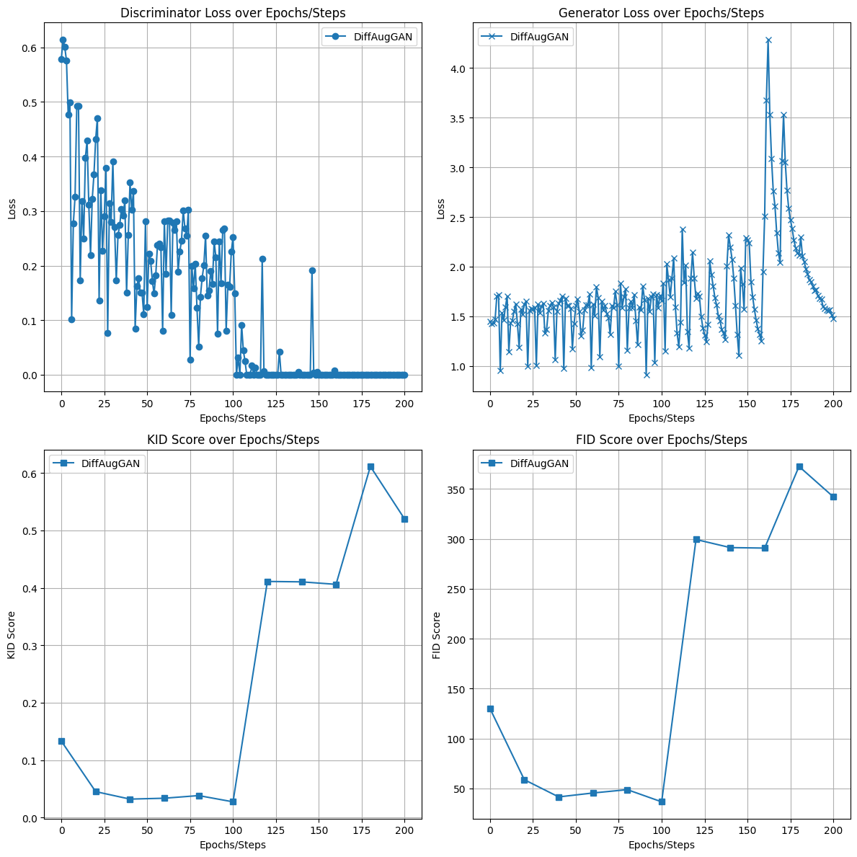
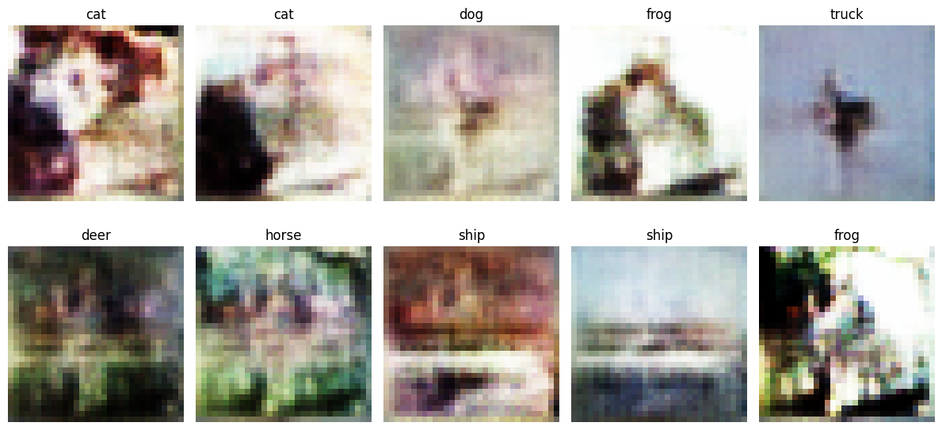
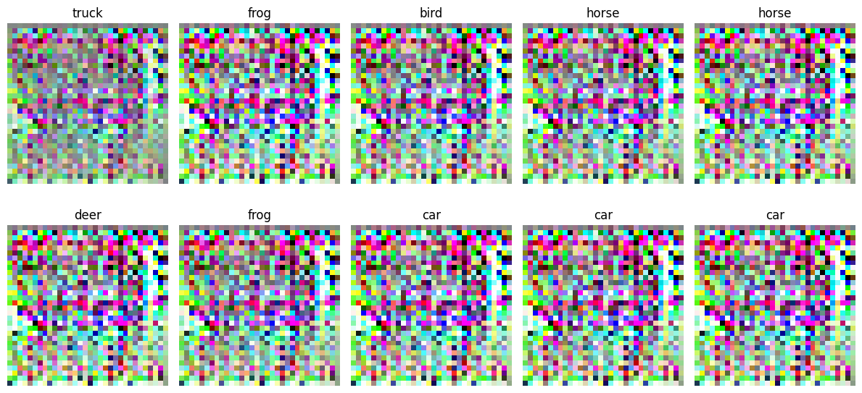
Final model improvement result
Originally, DiffAugment seem to perform really well, with FID and KID reaching all time low.
However, things go out of hand after 100 epochs and it become terrible.
Images before collapse:
Images after collapse:

Slide 32
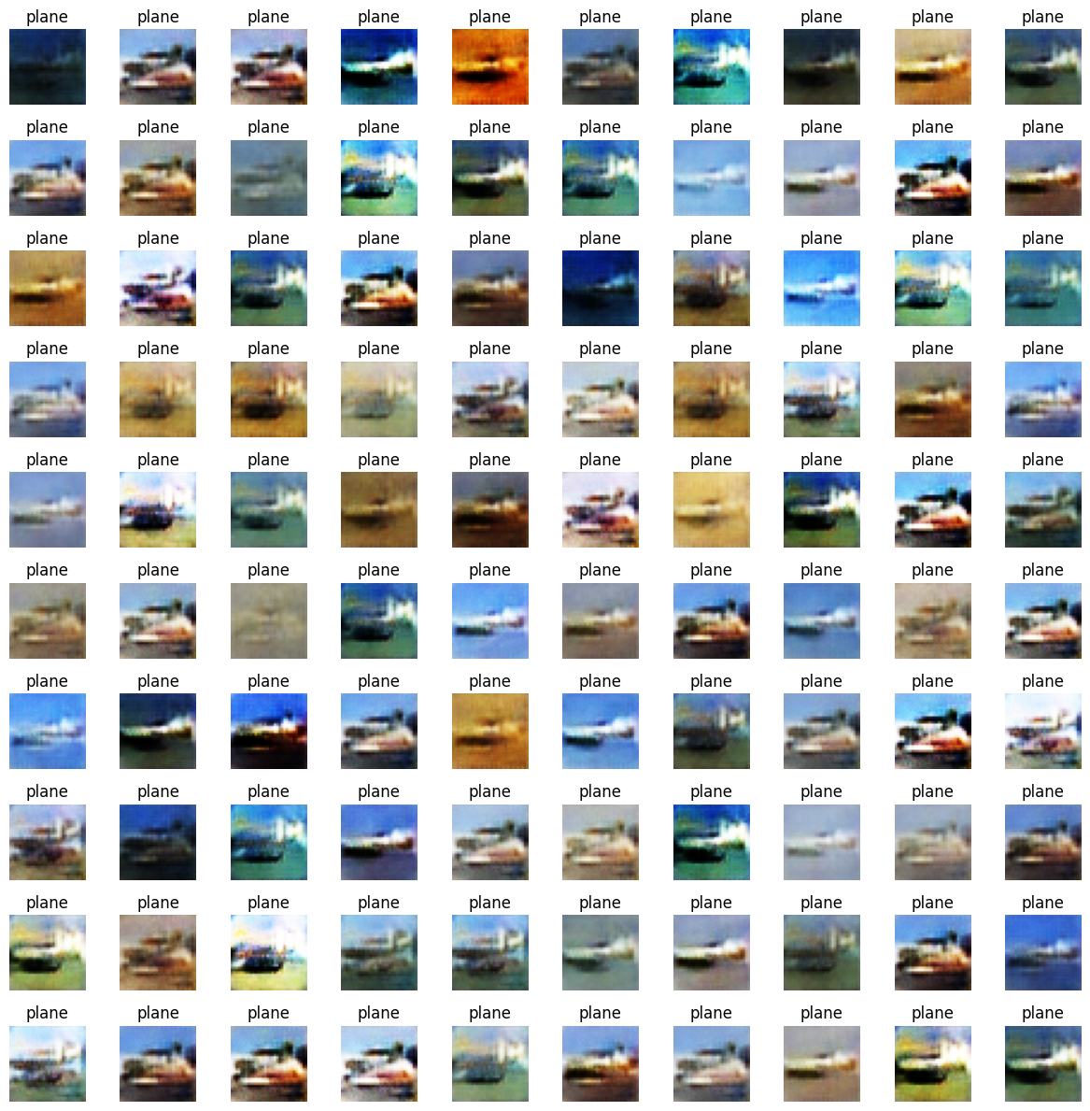
Plane

Slide 33
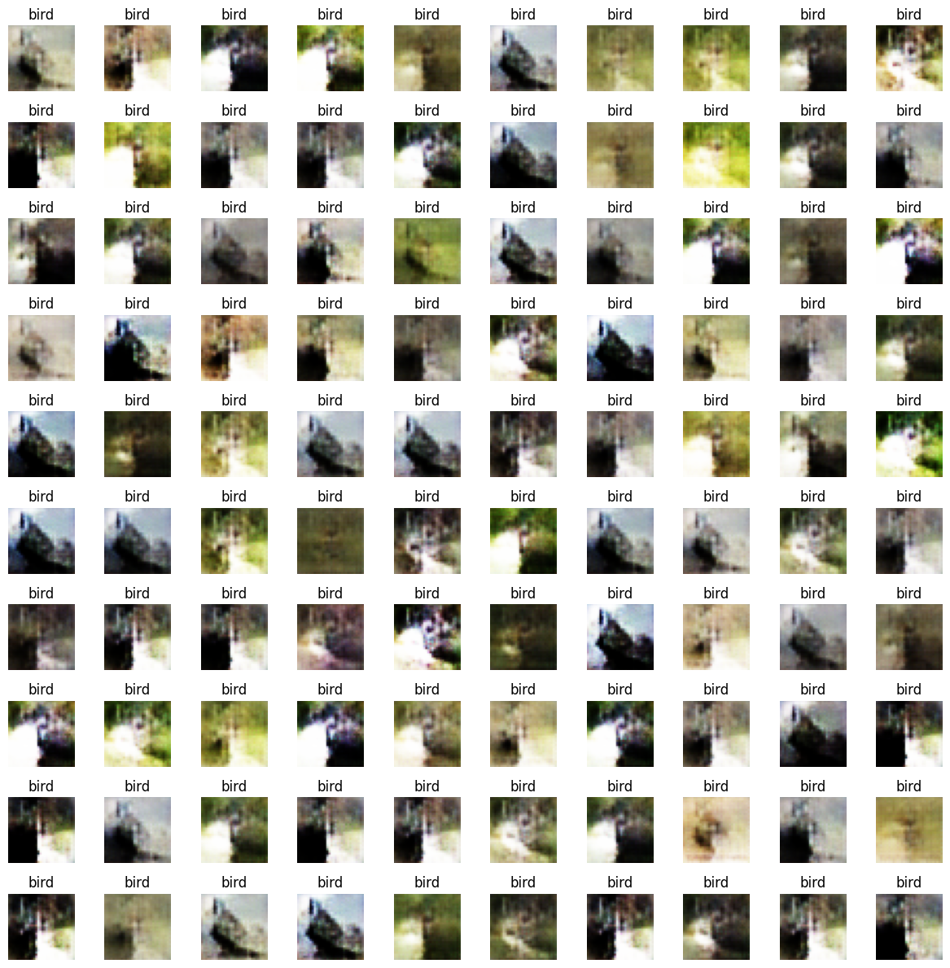
Bird

Slide 34
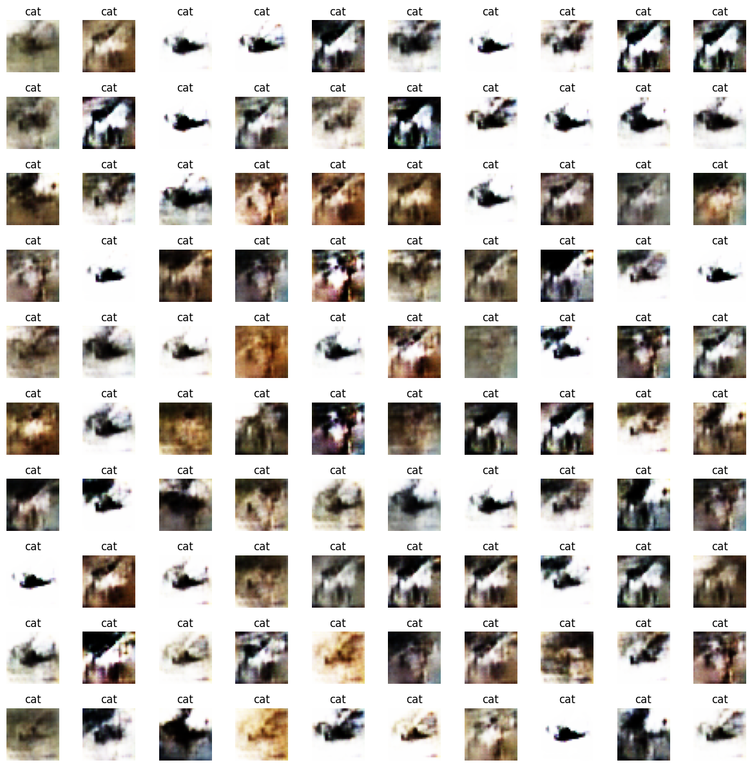
Cat

Slide 35
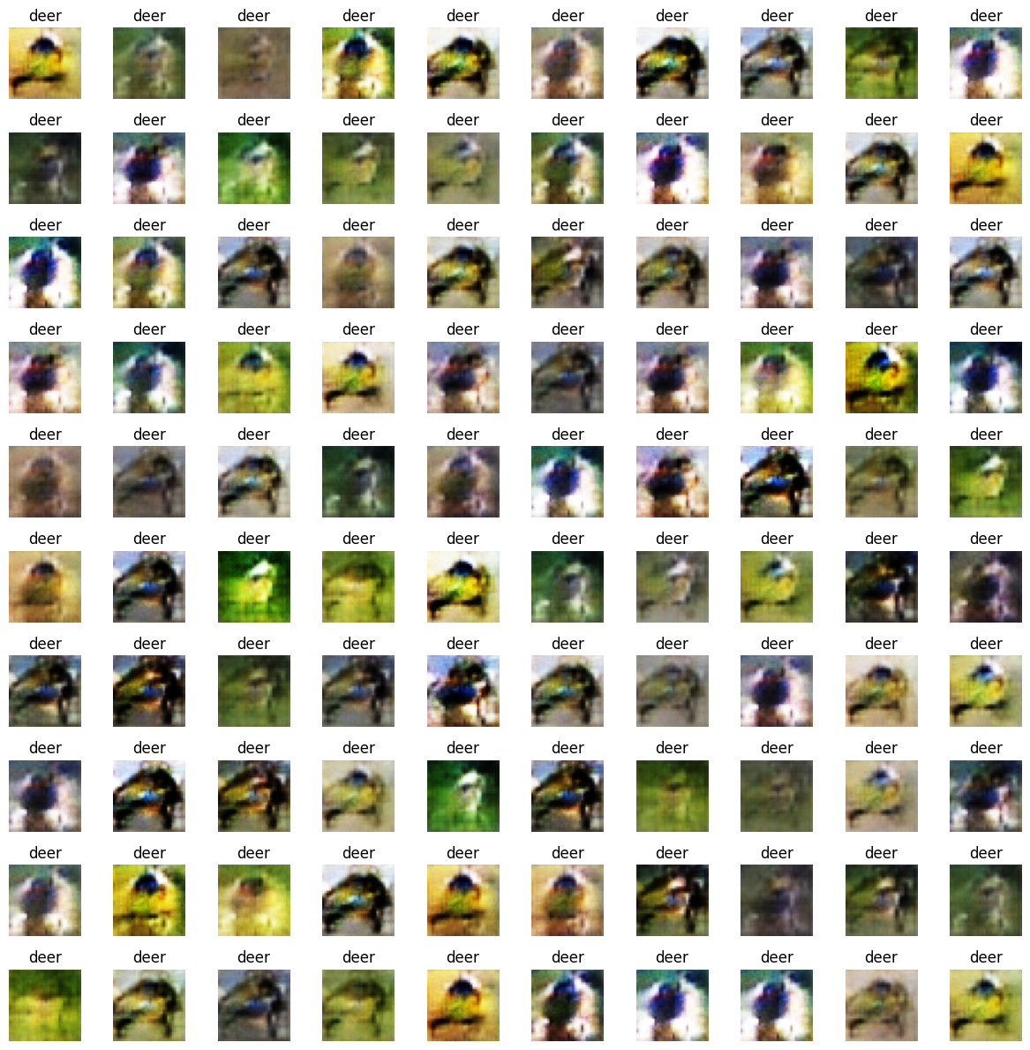
Deer

Slide 36
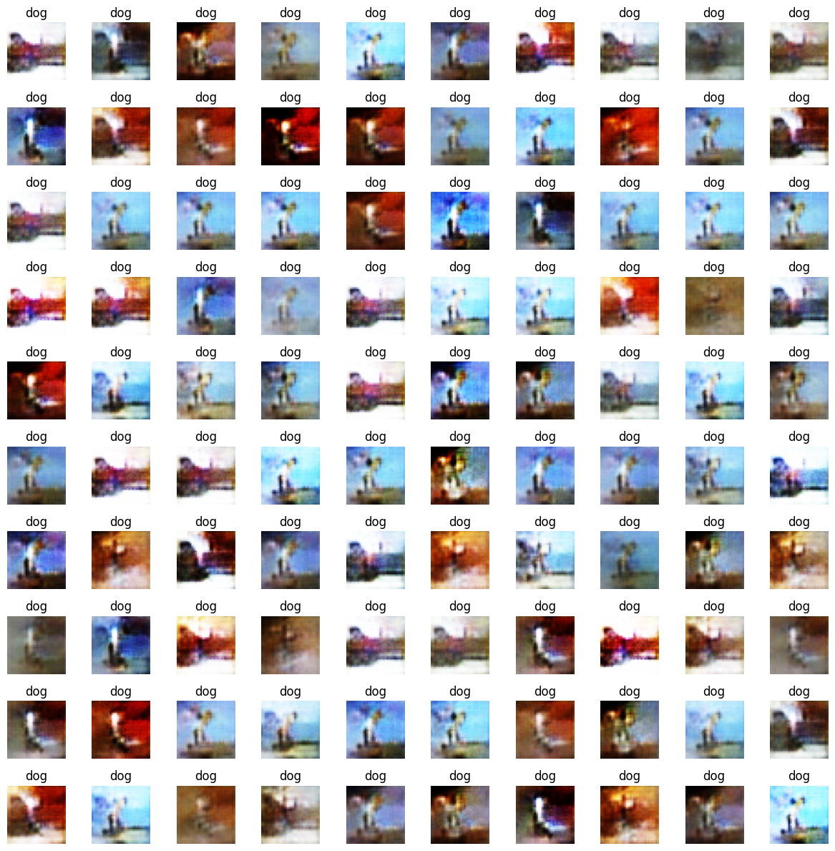
Dog

Slide 37
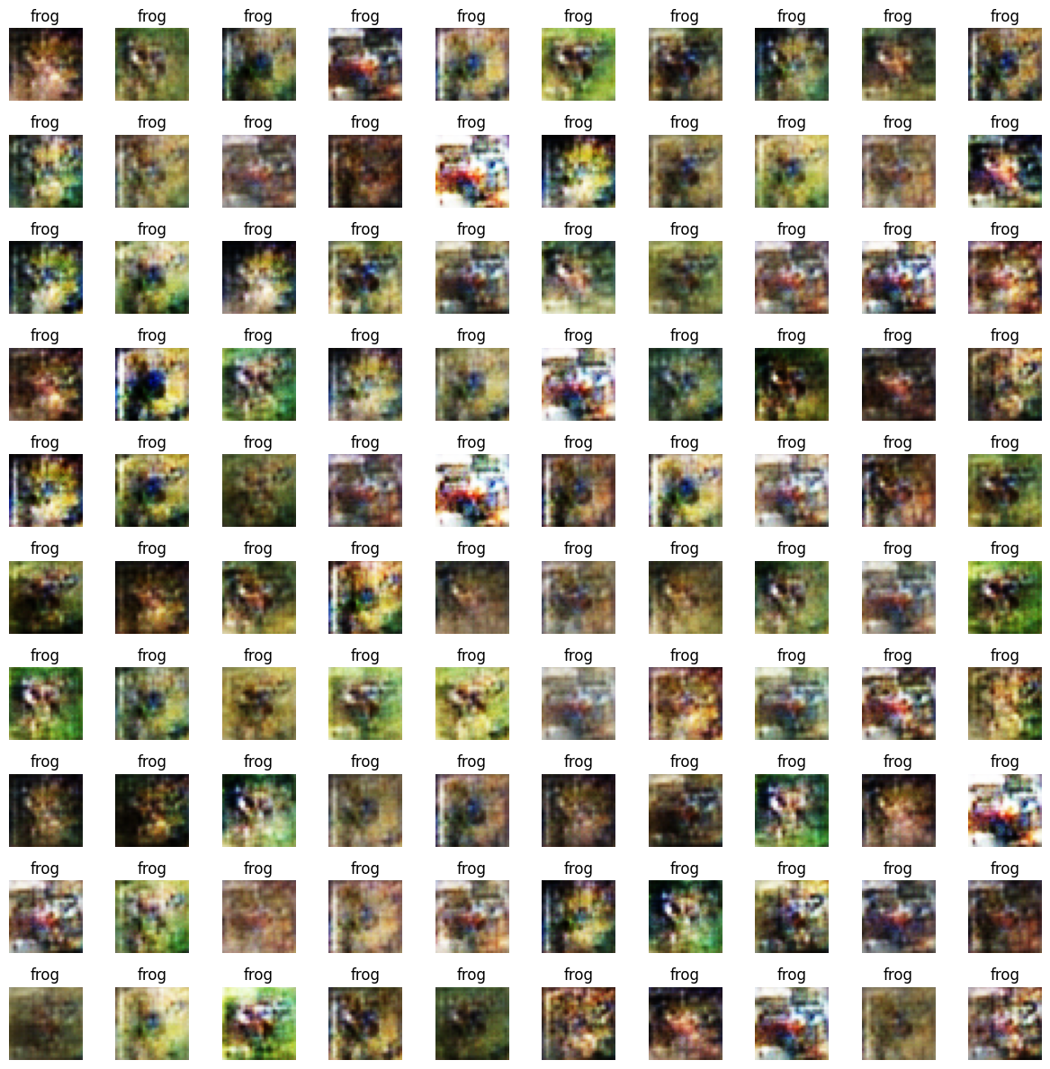
Frog

Slide 38
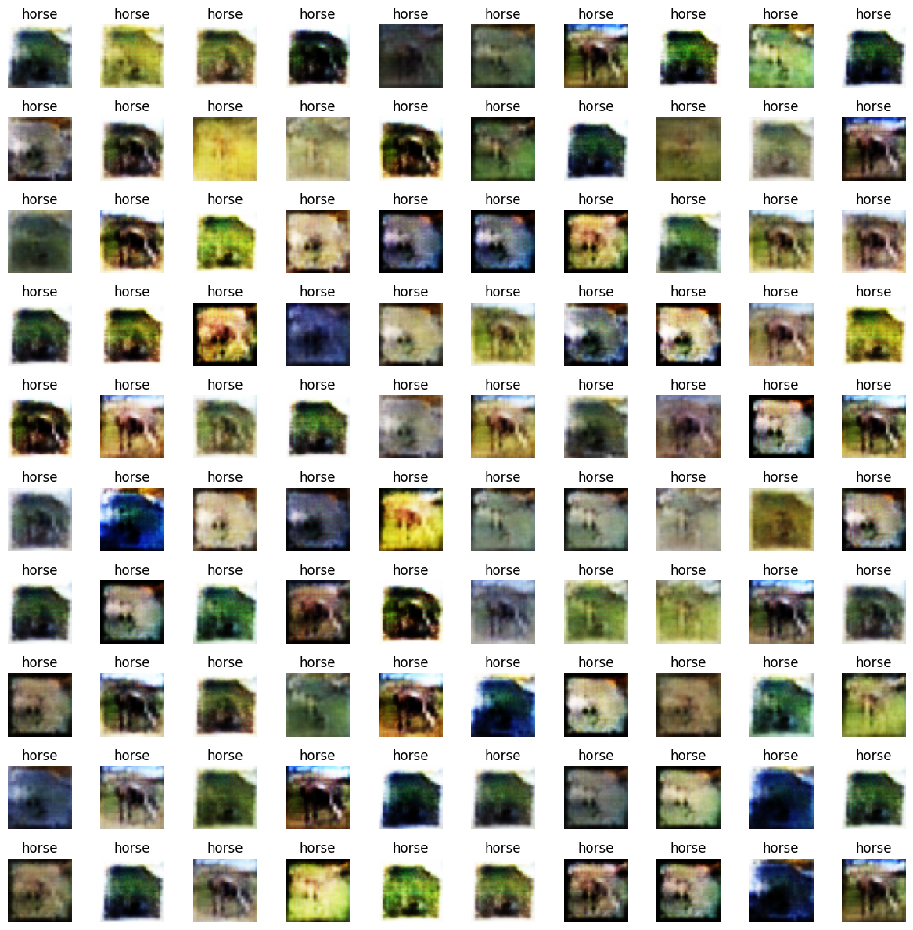
Horse

Slide 39
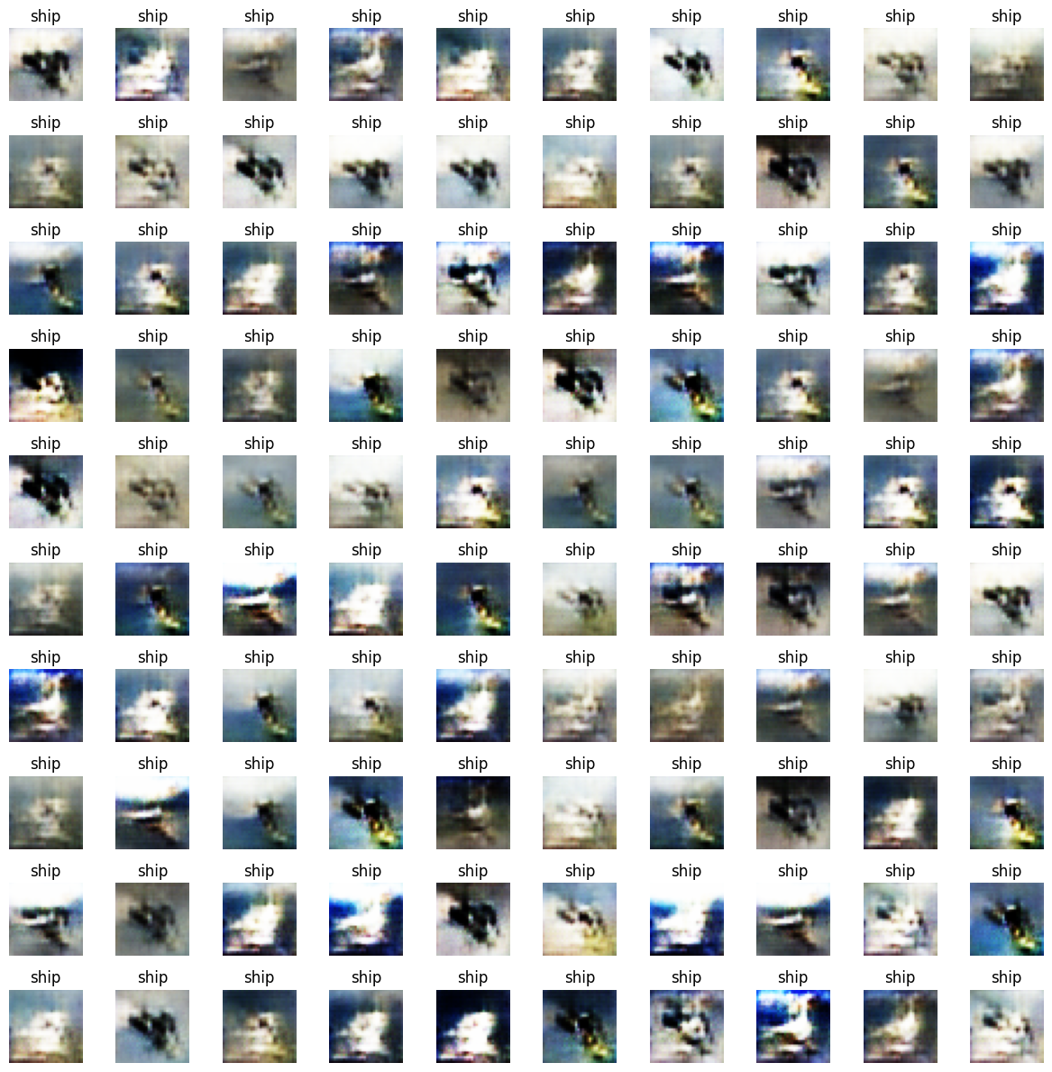
Ship

Slide 40
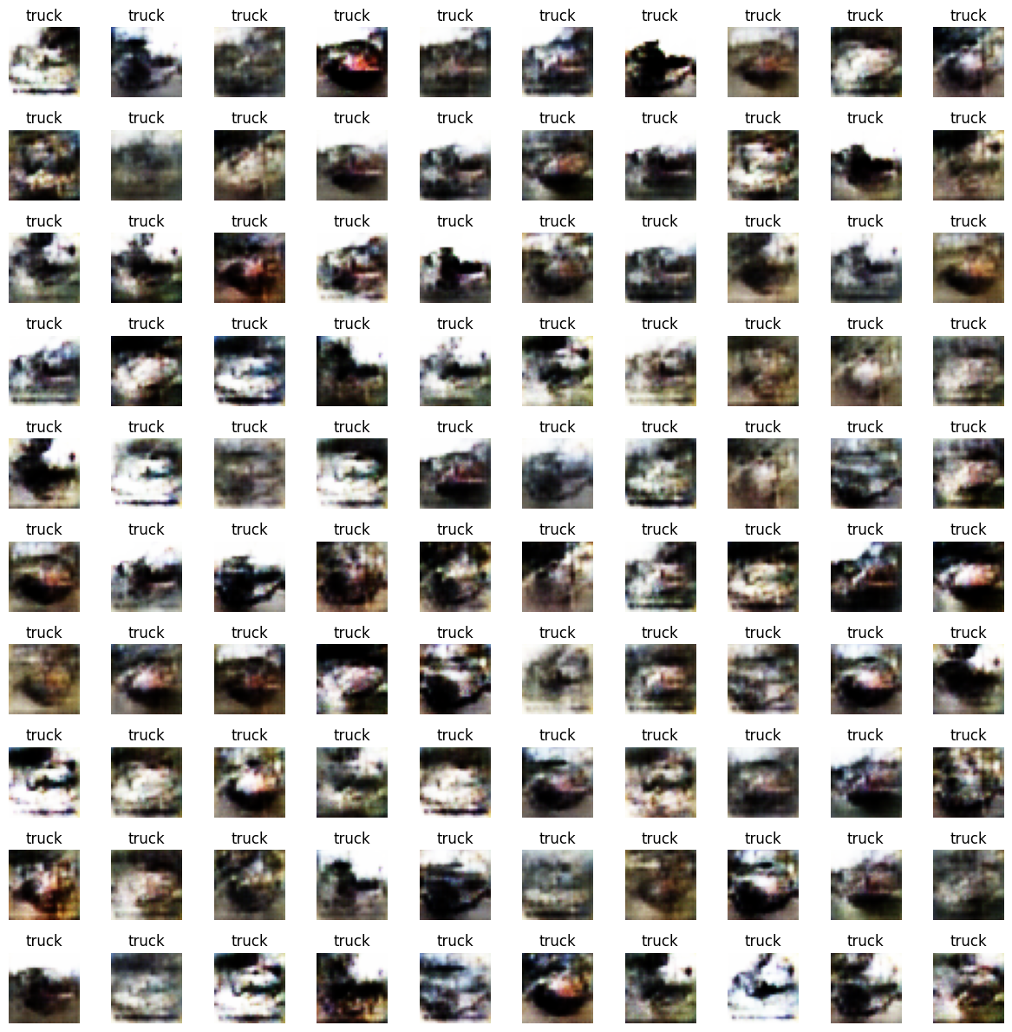
Truck

Slide 41
Final Thoughts
Image Quality
Captures environment and overall details
Conditoning of Images was successful
Mode collapse observed more many classes but Trucks, Ship and Plane were relatively diverse
Limitations:
Dataset has poor quality images, even after reclasifying some of the images were of ambiguous class
Model limitation. Our small convolution models were not capable of storing all the information to generate images. Maybe more complex architecture could have suceeded

Slide 42
Failed experiment
Here are the following techniques that we try to do but failed:
Build the FID metric with Torch-Fidelity library, but due to the library being outdated, we were unable to make use of it.
We tried to use conditioning batch normalisation but it does not work for us.
We also tried different loss functions such as Hinge Loss and Wasserstein loss but they did not improve our model
We considered using ResNet style architecture as we think our current model is not complex enough, but ResNet will require too much time and resource to compute.

Slide 43
Machine Learning Infographics
Artificial Intelligence
Machine learning
Vs
Computers act on their own
They act according to environment
Systems display cognitive ability
Computers make decisions
It’s an application of AI
Computers observe and analyze
Predict based on previous patterns
Pre-programmed algorithms

Slide 44
Machine Learning Infographics
Supervised learning
Unsupervised learning
Reinforcement learning
Classification
Reduction
Fraud detection
Email spam detection
Diagnostics
Image classification
Text mining
Data visualization
Face detection
Voice detection
Finances
Manufacturing
Stock management
Autonomous cars
Regression
Regression
Risk assessment
Score prediction
City planning
Targeted marketing

Slide 45
Machine Learning Infographics
Spam filtering
Mercury is the closest planet to the Sun
Some machine learning applications
Mobile banking
The Earth is the planet where we all live
Risk assessment
Despite being red, Mars is a cold place
Social networks
Jupiter is the biggest planet of them all

Slide 46
Machine Learning Infographics
01
02
Venus
Mercury
Venus has a beautiful name, but it’s hot
Mercury is the closest planet to the Sun

Slide 47
Machine Learning Infographics
01
02
Mercury
Venus
Mercury is the closest planet to the Sun
Machine learning
Venus has a beautiful name, but it’s hot
Yes, Saturn is a gas giant that has several rings
03
04
Earth
Mars
The Earth is the third planet from the Sun
Despite being red, Mars is a cold place

Slide 48
Machine Learning Infographics
01
Power
AI
Memory
02
Mercury is the closest planet to the Sun
Neptune is the farthest planet from the Sun
System configuration
03
Memory
Mars
04
Jupiter is a gas giant and the biggest planet
Despite being red, Mars is a cold place
05
Security
FPGA
06
Venus has a beautiful name, but it’s hot
Pluto is considered a dwarf planet
07
MCU
Wireless
08
The Earth is the third planet from the Sun
Ceres is located in the main asteroid belt

Slide 49
Machine Learning Infographics
Artificial intelligence
Mercury is the closest planet to the Sun
Machine learning
Jupiter is a gas giant and the biggest planet
Deep learning
Venus has a beautiful name, but it’s hot

Slide 50
Machine Learning Infographics
Output unit
Neural network
Yes, Saturn is a gas giant that has rings
01
Output layer
02
Input layer
Input unit 1
Input unit 2

Slide 51
Machine Learning Infographics
01
02
03
04
1950s
1960s
1970s
1980s
Simple algorithms
Bayesian methods
AI winter caused by pessimism
Resurgence in ML research
Mercury is the closest planet to the Sun
Jupiter is a gas giant and the biggest planet
Venus has a beautiful name, but it’s very hot
Mercury is the closest planet to the Sun
05
06
07
1990s
2000s
2010s
Data-driven approach
Support-Vector Clustering
Deep learning popularity
The Earth is the third planet from the Sun
Ceres is located in the main asteroid belt
Venus has a beautiful name, but it’s very hot

Slide 52
Machine Learning Infographics
01
02
Image recognition
Customization
The Earth is the planet where we live
Despite being red, Mars is a cold place
03
04
Voice recognition
Opportunities of machine learning
Data analysis
Venus has a beautiful name, but it’s hot
The Earth is the third planet from the Sun
05
06
Optical recognition
Memory data
Mercury is the closest planet to the Sun
Pluto is considered a dwarf planet

Slide 53
Machine Learning Infographics
Machine learning
The model
Venus has a beautiful name, but it’s hot
Despite being red, Mars is a cold place
Input 1
Input 2
The Earth is the third planet from the Sun
Mercury is the closest planet to the Sun

Slide 54
Machine Learning Infographics
01 | Supervised learning
 | Venus has a beautiful name, but it’s hot
02 | Unsupervised learning
 | Despite being red, Mars is a cold place
03 | Semi-supervised learning
 | The Earth is the third planet from the Sun
04 | Reinforcement learning
 | Mercury is the closest planet to the Sun
05 | Dimensionality reduction
 | Pluto is considered a dwarf planet

Slide 55
Machine Learning Infographics
01
Active learning
Maturation
02
Mercury is the closest planet to the Sun
Jupiter is a gas giant and the biggest planet
03
Motor synergies
Imitation
04
The Earth is the planet where we live
Despite being red, Mars is a cold place

Slide 56
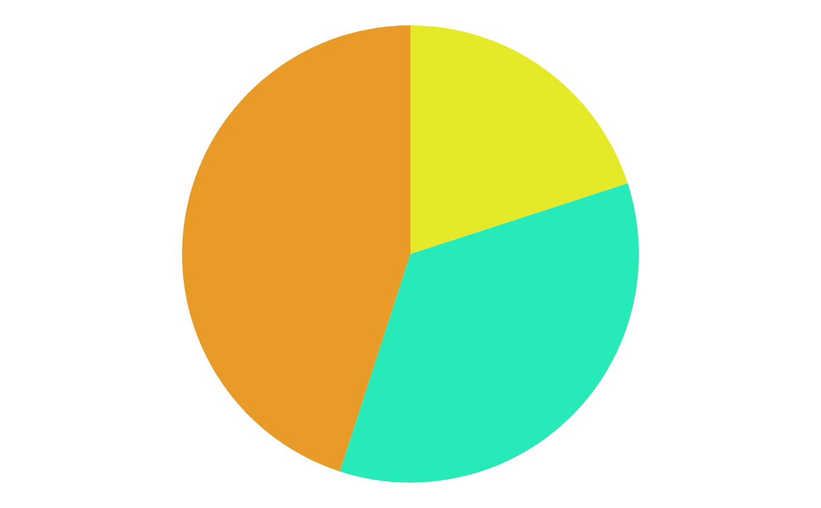
Machine Learning Infographics
45%
20%
Data mining
Intrusion detection
The Earth is the third planet from the Sun
Mercury is the closest planet to the Sun
35%
Continuous production
Despite being red, Mars is a very cold place
Follow the link in the graph to modify its data and then paste the new one here. For more info, click here

Slide 57
Machine Learning Infographics
01
Classify data
Mercury is the closest planet to the Sun
Machine learning objectives
02
Make predictions
The Earth is the planet where we live

Slide 58
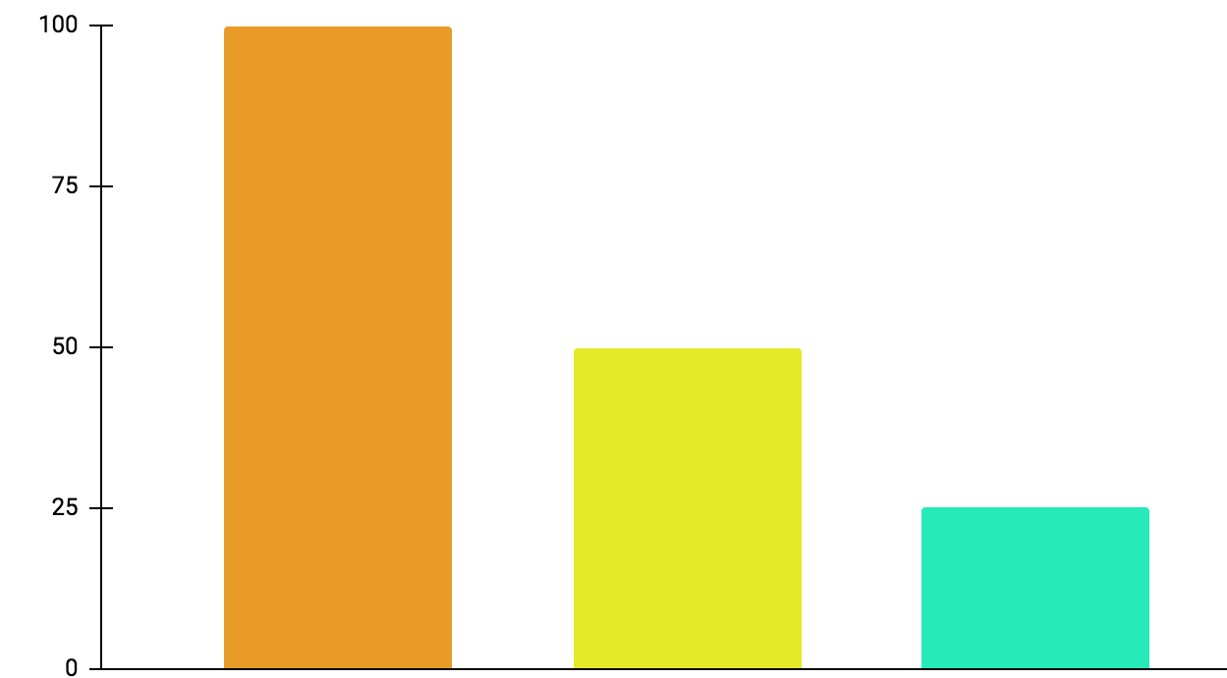
Machine Learning Infographics
01
Active learning
Mercury is the closest planet to the Sun
02
Maturation
Jupiter is a gas giant and the biggest planet
03
Motor synergies
Neptune is very far away from the Sun
100%
50%
25%
Follow the link in the graph to modify its data and then paste the new one here. For more info, click here

Slide 59
Machine Learning Infographics
Models
Artificial neural networks | The Earth is the planet we live on
Decision trees | Mercury is the smallest planet
Support-vector machines | Despite being red, Mars is a cold place
Regression analysis | Jupiter is the biggest planet of them all
Bayesian networks | Venus has a beautiful name
Genetic algorithms | Pluto is considered a dwarf planet

Slide 60
Machine Learning Infographics
Collect the data
Prepare the data
Mercury is the closest planet to the Sun
The Earth is the third planet from the Sun
Train a model
Despite being red, Mars is a cold place
Improve
Evaluate the model
Pluto is considered a dwarf planet
Jupiter is the biggest planet of them all

Slide 61
Machine Learning Infographics
Inputs
Outputs
Mercury is the closest planet to the Sun
Jupiter is a gas giant and the biggest planet
Input 1
Output 1
Input 2
Output 2
Input 3
Output 3

Slide 62
Machine Learning Infographics
Predict trends
01
02
Innovation
Venus has a beautiful name, but it’s hot
Despite being red, Mars is a cold place
Target segmentation
03
Cost reduction
04
Mercury is the closest planet to the Sun
Neptune is very far away from the Sun
Advert segmentation
05
06
Customer relations
ML for business
The Earth is the third planet from the Sun
Jupiter is the biggest planet of them all

Slide 63
Machine Learning Infographics
Machine learning application example
Polite
Offensive
01
02
03
04
Tweet
Feature engineering
Classification
Output
Mercury is the closest planet to the Sun
Venus has a beautiful name, but it’s hot
The Earth is the third planet from the Sun
Despite being red, Mars is a cold place

Slide 64
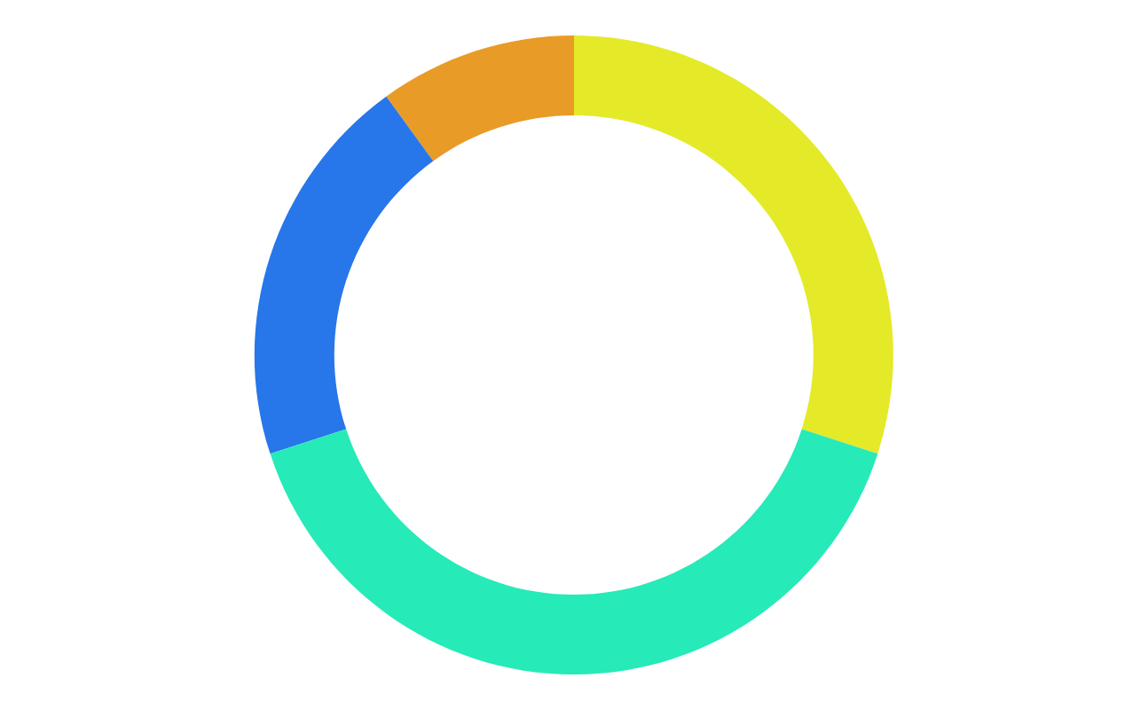
Machine Learning Infographics
10%
30%
Mercury
Jupiter
Mercury is the closest planet to the Sun
Jupiter is a gas giant and the biggest planet
20%
40%
Neptune
Mars
It’s the farthest planet from the Sun
Despite being red, Mars is a cold place
Follow the link in the graph to modify its data and then paste the new one here. For more info, click here

Slide 65
Machine Learning Infographics
Biochemical analysis
Disease diagnosis
Drug discovery
Mercury is the closest planet to the Sun
Venus has a beautiful name, but it’s hot
The Earth is the third planet from the Sun

Slide 66
Machine Learning Infographics
Input data
Neptune
Mars
It’s the farthest planet from the Sun
Despite being red, Mars is a cold place
Learning system
Mercury is the closest planet to the Sun
Output data

Slide 67
Machine Learning Infographics
Machine learning advantages vs disadvantages
Advantages
Disadvantages
Efficiency data managing
Continuous improvement
Lots of applications
Trend identification
Pattern identification
Data acquisition
Time and space
Time-consuming
High error possibilities
Algorithm selection

Slide 68
Machine Learning Infographics
01
02
03
Identify data
Choose algorithm
Analytical model
Venus has a beautiful name, but it’s hot
Mercury is the closest planet to the Sun
Despite being red, Mars is a cold place
04
05
Train the model
Run the model
Jupiter is the biggest planet of them all
Neptune is very far away from the Sun

Slide 69
Machine Learning Infographics
Input data
Jupiter is the biggest planet of them all
Relationships
Patterns
Machine learning
Algorithms + techniques
Dependencies
Structures
Output
Despite being red, Mars is a cold place

Slide 70
Instructions for use
In order to use this template, you must credit Slidesgo in your final presentation.
You are allowed to:
- Modify this template.
- Use it for both personal and commercial projects.
You are not allowed to:
- Sublicense, sell or rent any of Slidesgo Content (or a modified version of Slidesgo Content).
- Distribute Slidesgo Content unless it has been expressly authorized by Slidesgo.
- Include Slidesgo Content in an online or offline database or file.
- Offer Slidesgo templates (or modified versions of Slidesgo templates) for download.
- Acquire the copyright of Slidesgo Content.
For more information about editing slides, please read our FAQs or visit Slidesgo School:
https://slidesgo.com/faqs and https://slidesgo.com/slidesgo-school

Slide 71
Instructions for use (premium users)
In order to use this template, you must be a Premium user on Slidesgo.
You are allowed to:
Modify this template.
Use it for both personal and commercial purposes.
Hide or delete the “Thanks” slide and the mention to Slidesgo in the credits.
Share this template in an editable format with people who are not part of your team.
You are not allowed to:
Sublicense, sell or rent this Slidesgo Template (or a modified version of this Slidesgo Template).
Distribute this Slidesgo Template (or a modified version of this Slidesgo Template) or include it in a database or in any other product or service that offers downloadable images, icons or presentations that may be subject to distribution or resale.
Use any of the elements that are part of this Slidesgo Template in an isolated and separated way from this Template.
Register any of the elements that are part of this template as a trademark or logo, or register it as a work in an intellectual property registry or similar.
For more information about editing slides, please read our FAQs or visit Slidesgo School:
https://slidesgo.com/faqs and https://slidesgo.com/slidesgo-school

Slide 72
Infographics
You can add and edit some infographics to your presentation to present your data in a visual way.
Choose your favourite infographic and insert it in your presentation using Ctrl C + Ctrl V or Cmd C + Cmd V in Mac.
Select one of the parts and ungroup it by right-clicking and choosing “Ungroup”.
Change the color by clicking on the paint bucket.
Then resize the element by clicking and dragging one of the square-shaped points of its bounding box (the cursor should look like a double-headed arrow). Remember to hold Shift while dragging to keep the proportions.
Group the elements again by selecting them, right-clicking and choosing “Group”.
Repeat the steps above with the other parts and when you’re done editing, copy the end result and paste it into your presentation.
Remember to choose the “Keep source formatting” option so that it keeps the design. For more info, please visit Slidesgo School.

